Slide 1

Capstone Project
Smart Cloud Quiz: Google Sheet Based Quiz Application
CSA3103 Cloud Storage and Security for Big
Data Applications
Supervisor Student Details
Dr.Mahaveerakannan Shaik Nafeesa
Course Faculty 192111182
Saveetha School of Engineering Saveetha School of Engineering
Notes:
1
1

Slide 2
INDEX
Introduction
Problem Statement
Aim of the Project
Objectives
Common Browser Security Threats
Research Gap
Techstack Used
Implementation Steps
Code Snippets
Outputs
Future Scope
References
Notes:
2
2

Slide 3
Introduction
Need for Flexible Assessments – Educators and organizations require cost-effective, accessible assessment tools without complex infrastructure.
Limitations of Traditional Quiz Systems – Existing solutions often lack scalability, customization, and real-time data tracking, making them inefficient.
Google Sheets-Based Quiz Solution – Utilizes Google’s cloud ecosystem to streamline quiz management, automated grading, and real-time response tracking.
Seamless Data Storage & Collaboration – Enables dynamic updates, instant response analysis, and automation using Google Apps Script.
Enhanced Efficiency & Security – Eliminates dependency on third-party platforms, reducing costs while ensuring secure and adaptable assessments.
Real-Time Insights & Analytics – Built-in analytics tools help educators and organizations derive valuable insights for better assessment strategies.

Slide 4
Problem Statement
Traditional quiz systems lack scalability, adaptability, and security, making them inefficient for modern educational needs.
Traditional systems do not support seamless integration with cloud tools for real-time data synchronization and team collaboration.
Cost & Infrastructure Challenges – Advanced quiz platforms often require expensive subscriptions or dedicated infrastructure, making them inaccessible for many users.
Security issues such as weak authentication, minimal proctoring, and high risks of cheating or data breaches remain prevalent.

Slide 5
Aim of the Project
Develop a cloud-based quiz application that is scalable, adaptive, and secure for modern learning assessments.
Ensure real-time response tracking, automated grading, and seamless quiz management using cloud technology.
Enhance assessment accuracy and efficiency by incorporating AI-driven adaptability and dynamic question sets.
Strengthen security with features like authentication, anti-cheating mechanisms, and encrypted data storage.
Reduce infrastructure costs and eliminate dependency on third-party platforms by leveraging Google Sheets and Google Apps Script for seamless integration.

Slide 6
Objectives
Develop a Scalable and Adaptive Quiz System – Ensure the platform can handle large-scale assessments efficiently.
Enable Real-Time Assessment Tracking – Implement live response tracking and automated grading for instant feedback.
Enhance Security and Data Integrity – Integrate authentication mechanisms, anti-cheating features, and encrypted data storage.
Leverage Google Sheets for Seamless Integration – Utilize Google Apps Script to automate workflows, store quiz data, and enable collaboration.
Ensure Cost-Effectiveness and Accessibility – Reduce infrastructure costs while making assessments more flexible and widely available.

Slide 7
Common Browser Security Threats
Phishing Attacks – Attackers may create fake quiz links to trick users into entering sensitive information.
Unauthorized Access – Weak permissions settings may allow unauthorized users to modify quiz questions or responses.
Data Leakage – Unsecured sharing settings in Google Sheets could expose quiz data to unintended users.
Man-in-the-Middle (MITM) Attacks – If users access the quiz over an unsecured network, hackers can intercept responses.

Slide 8
RESEARCH GAP
Limited Customization – Most platforms provide fixed templates, restricting flexibility in quiz design, question types, and user interface modifications.
Scalability Limitations – Traditional quiz systems struggle to handle high traffic during large-scale assessments, causing performance issues.
Inconsistent User Experience Across Devices – Some quiz platforms do not optimize the interface for different screen sizes, leading to poor usability on mobile devices.

Slide 9
Techstack Used
📌 Frontend: 🔹 HTML – Structure of the quiz interface. 🔹 CSS – Styling and UI enhancements. 🔹 JavaScript – Dynamic behavior, form validation, and API interactions.
📌 Backend & Scripting: 🛠️ Google Apps Script – Automates quiz functionality, grading, and data handling within Google Sheets.
📌 Database & Storage: 📊 Google Sheets – Stores quiz questions, user responses, and scores.
📌 Authentication & Security: 🔒 Google OAuth – User authentication for secure access. 📁 Google Drive Permissions – Controls access levels to quiz data.
📌 Deployment & Hosting: ☁️ Google Cloud Functions – (Optional) For additional backend processing.

Slide 10
Implementation Steps
1️⃣ Setup Google Sheets
Create a Google Sheet to store quiz questions, options, correct answers, and user responses.
2️⃣ Design the Quiz Interface
Use HTML, CSS, and JavaScript to create an interactive quiz interface.
3️⃣ Integrate Google Apps Script
Write scripts to fetch questions from Google Sheets and record user responses.
4️⃣ Implement Quiz Logic
Add features like time limits, multiple-choice validation, and scoring mechanisms.
5️⃣ Enable Authentication & Security
Use Google OAuth for user authentication and set permissions for quiz access.

Slide 11
6️⃣ Automate Grading & Response Storage
Store responses in Google Sheets and automate grading using Apps Script.
7️⃣ Real-Time Data Tracking & Analysis
Implement Google Sheets formulas or Google Apps Script to generate reports.
8️⃣ Testing & Debugging
Test for UI responsiveness, security vulnerabilities, and functionality errors.
9️⃣ Deployment & Hosting
Publish the quiz app via Google Apps Script or host it using Firebase for better performance.
🔟 User Feedback & Enhancements
Collect user feedback, analyze results, and update the quiz features accordingly.

Slide 12
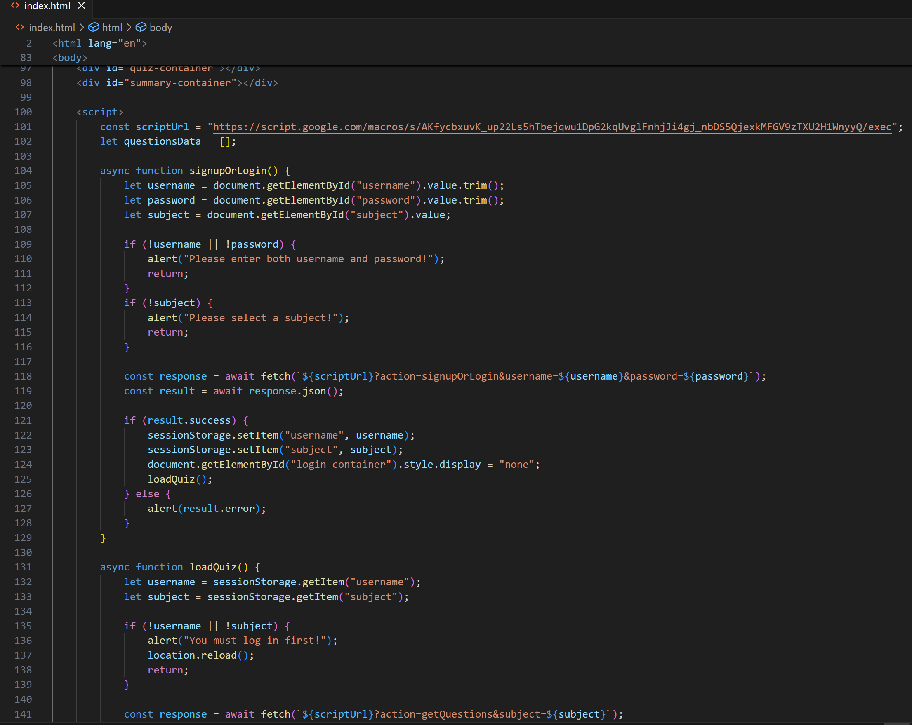
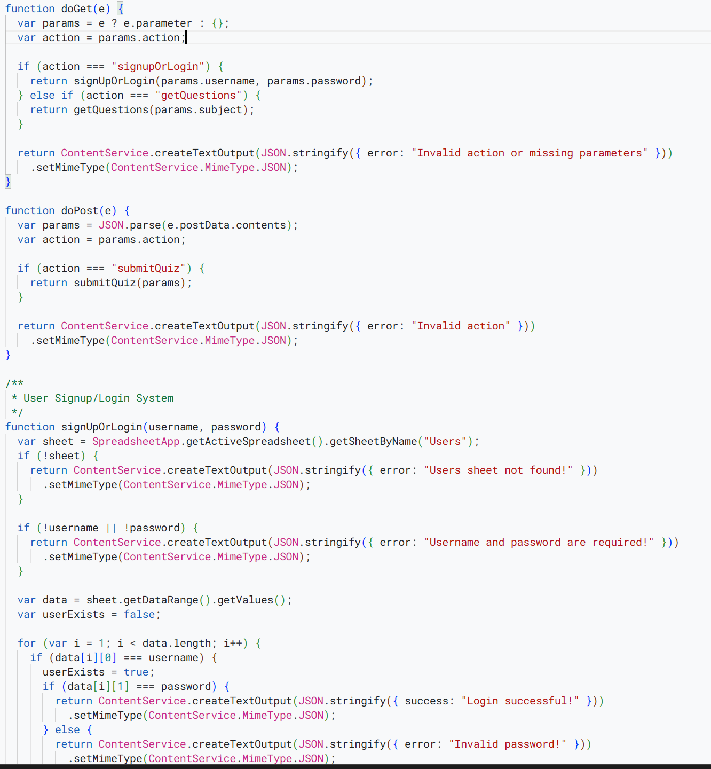
Code Snippets

Slide 13
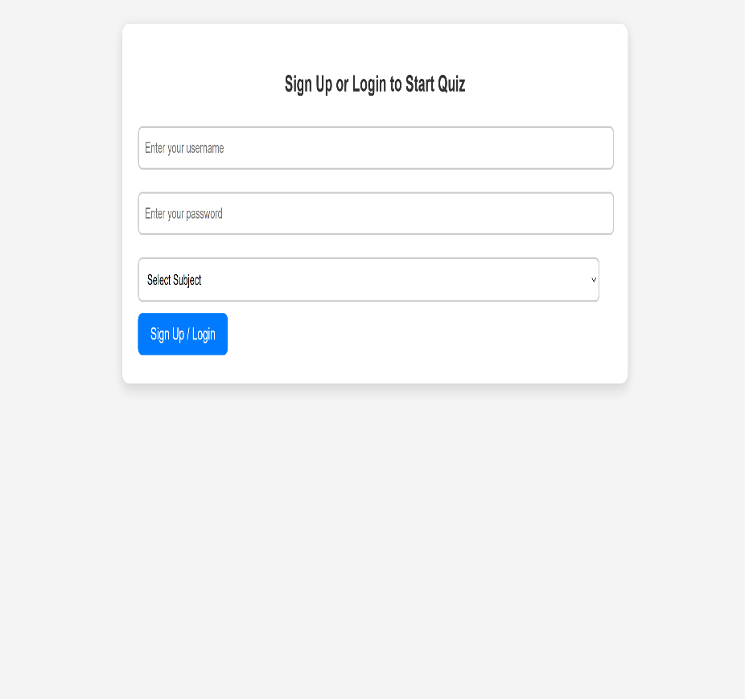
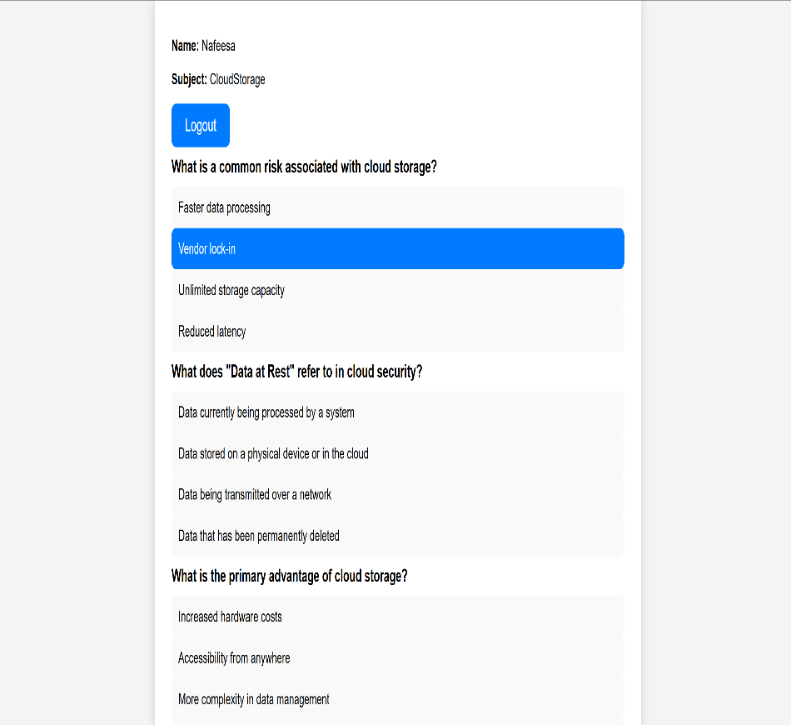
Outputs

Slide 14
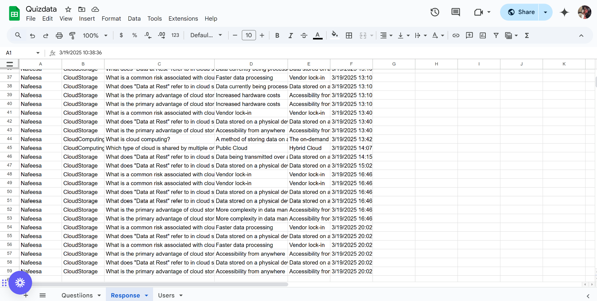

Slide 15
Future Scope
🚀 1. AI-Driven Adaptive Learning
Implement AI-based question selection to personalize quizzes based on user performance.
📊 2. Advanced Analytics & Insights
Integrate AI/ML to provide in-depth performance analysis and predictive learning insights.
🔒 3. Enhanced Security Features
Introduce two-factor authentication, anti-cheating mechanisms, and blockchain-based verification.
🌍 4. Multi-Language & Accessibility Support
Expand to support multiple languages and accessibility features for a wider audience.
📡 5. Cloud-Based Scalability
Integrate with cloud services (Firebase, AWS, or Google Cloud) for high-traffic handling.

Slide 16
References
Smith, J., & Taylor, K. (2023). "Cloud-Based Assessment Systems: Security and Scalability Challenges." Journal of Educational Technology & Security, 19(2), 78-92.
Chen, L., & Rao, P. (2022). "Enhancing Online Quizzes with AES Encryption: A Security Perspective." International Journal of Cyber Education, 15(4), 112-130.
Davis, M. (2021). "Adaptive Learning in Digital Assessments: AI-Driven Question Generation." Journal of Smart Learning Technologies, 24(1), 45-63.
Wilson, R., & Patel, A. (2020). "Cloud-Based Quiz Platforms: A Comparative Analysis of Security Features." Cyber Education Review, 10(3), 150-168.

